Slide 1
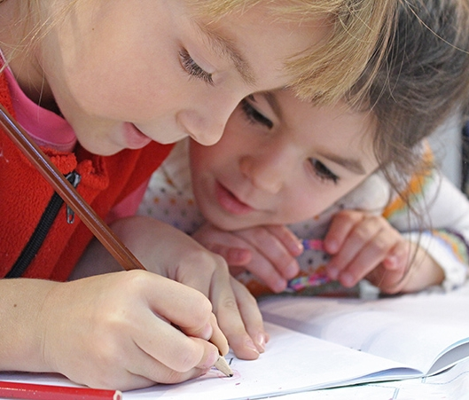

Dealing with Change
April
2020
Counselors’ Corner

Slide 2
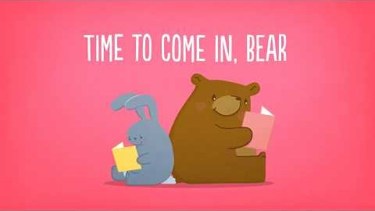
Time to Come In, Bear: A Children's Story About Social Distancing
Press play to watch the video for Primary Grades

Slide 3
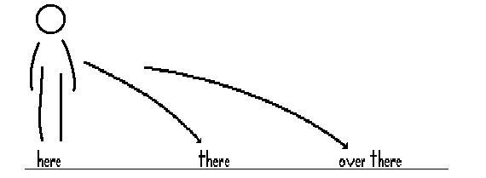
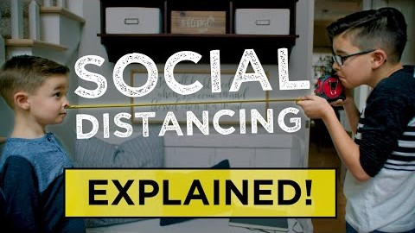
What is Social Distancing?
Press play to watch the video
For Intermediate Grades

Slide 4
Change &
Our Emotions
If you feel stressed about coronavirus, you're not alone. Coronavirus (COVID-19) has had ripple effects into almost every aspect of our lives. With schools and workplaces closed for now, it's affected the way we live every day. So much has changed in such a short time.
It's natural to feel worried or anxious when we face a crisis, the unknown, or sudden change. It's a normal reaction to feel the need for safety, certainty, predictability, and control.

Slide 5
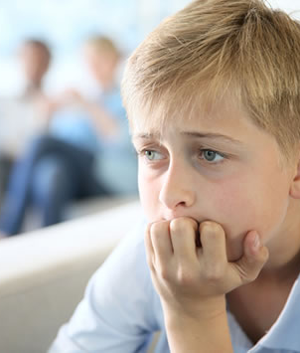
Anxiety (Intermediate)
What is Anxiety?
Anxiety is a normal emotion and serves as a signal to pay attention so we can protect ourselves. Anxiety alerts us. It prompts us to adapt. But when we're overwhelmed by anxiety, it sometimes can do more harm than good.
When anxiety becomes overwhelming, we're less able to rise to a challenge, and sometimes we can get stuck.

Slide 6
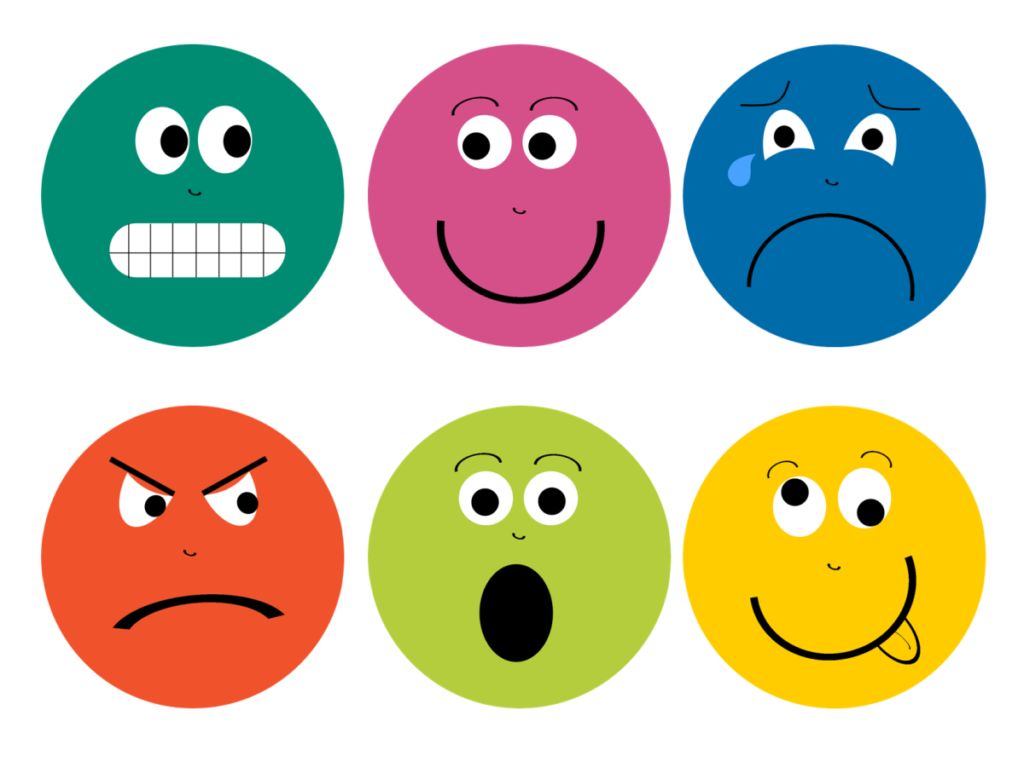
Helpful Tips
Notice, label, and accept your emotions.
Notice the sensations in your body for example fluttering in belly.
Quietly say to yourself, "OK, there's my worry again."
Accept your emotion without labeling it good or bad.
Bring yourself to the present moment using your senses

Slide 7
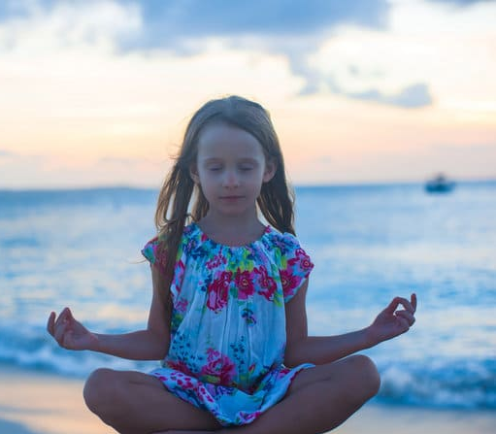
Mindfulness
5 things you can see
4 things you can feel
3 things you can hear
2 things you can smell
1 thing you can taste

Slide 8
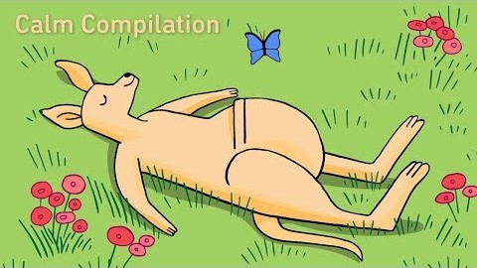
Primary grades try this…
Mindfulness Activity
Press play to watch the video

Slide 9
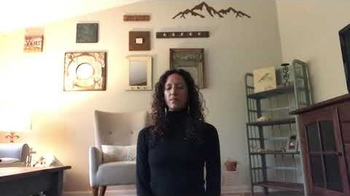
Mindful Moment: Intermediate

Slide 10
Breathe in calm,
Breathe out peace.
Sending peace and calm to you!

Slide 11
References
https://kidshealth.org/en/parents/coronavirus-calm.html
https://www.youtube.com/watch?fbclid=IwAR0LJtgNRpooptemmU5fCwe_1sXXHINQPSoLUgc1q6pkuC_raZ1E0MfTuMk&feature=youtu.be&v=DA_SsZFYw0w&app=desktop
https://www.youtube.com/watch?v=iEEJT9cYsm0

